Slide 1
Can I really consolidate my SQL Server database?
Denny Cherry
Senior Database Administrator / Architect
dcherry@awarenesstech.com
MVP, MCSA, MCDBA, MCTS, MCITP

Slide 2
Why we consolidate
Reduce server count
Reduce Cooling Costs
Reduce Power Costs
Reduce license costs
Take advantage of faster servers

Slide 3
Consolidation Options
Multiple Databases in a single instance
Multiple Instances on a single server
Multiple virtual servers into one physical server

Slide 4
Multiple Databases 1 Instance
Saves on License Costs
Saves on Hardware Costs
Shared Buffer Cache
Shared Procedure Cache
Shared CPUs
No control of buffer/proc cache size

Slide 5
Multiple Instances 1 Server
Save on License Costs
Save on Hardware Costs
Separate Buffer Cache
Separate Procedure Cache
Shared or Isolated CPUs
Influence buffer/proc cache sizes via max memory

Slide 6
Multiple virtual servers 1 host
Save on Hardware Costs
Can save on License costs
Separate Buffer Cache
Separate Procedure Cache
Shared or Isolated CPUs
Control of cache size by controlling VM resources

Slide 7
How to select a technique
CPU Load
Buffer Cache Size
Procedure Cache Size
Page Life Expectancy
Disk IO Load
Legacy Server CPU & RAM

Slide 8
When is it not going to work
All servers have high CPU Loads
All servers have large buffer cache requirements
One or more servers have large procedure cache requirements
JBOD can’t handle the IO
Single Server can’t handle the RAM

Slide 9
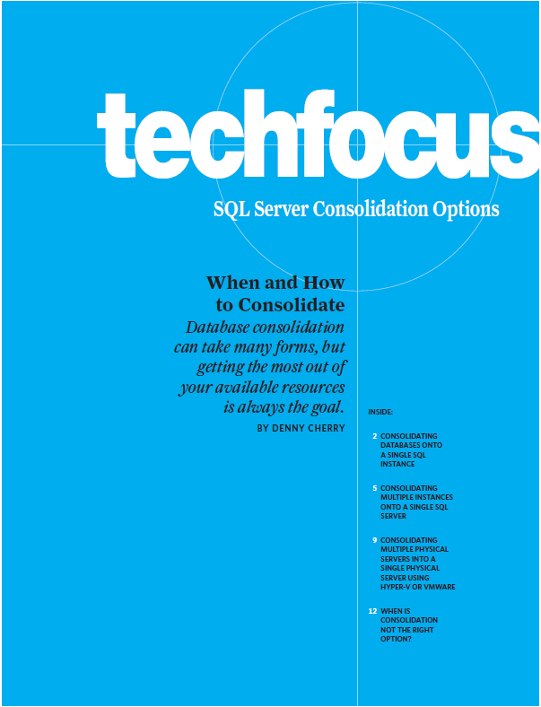
More Reading
When and How to Consolidate
http://bit.ly/bFx8il
Server Consolidation with SQL Server 2008 (MS)
http://bit.ly/catkb2
SQL Server Consolidation on the 64-Bit Platform (TechNet)
http://bit.ly/90Ql4M

Slide 10
Can I really consolidate my SQL Server database?
Denny Cherry
dcherry@awarenesstech.com
http://itke.techtarget.com/sql-server
Please rate this presentation at http://speakerrate.com/mrdenny

